Slide 1

QR code attendance
Staff

Slide 2
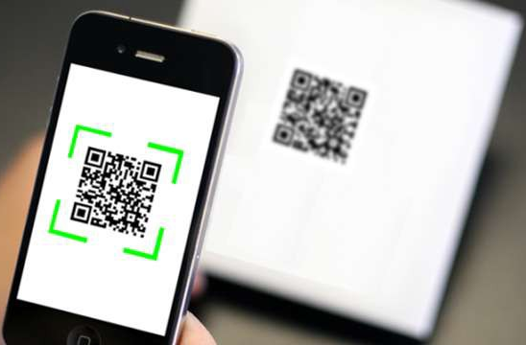
Attendance mobile application
1. Introduction
2. Scope
3. Team member and responsibility
4. Structure Project
5. gitHub project
6. prototype

Slide 3
Introduction
Staff attendance system using QR code
Most of all company are temporarily banning the use of biometrics in checking the staff' daily time records because of Covid-19 problem, the use of QR codes is a great technological substitute for checking their daily time records.
Since the staff only need to scan their corresponding QR code attendance, the chance of infecting each other with a communicable disease lessens.
Because of that, offices can use a QR code attendance into their attendance checking routines for a smooth and safe daily time recording.
Benefits of using a QR code attendance
QR codes are known to be the cost-efficient technological tool that many businesses use in keeping a contactless operation.
With the use of a QR code attendance system, institutions can implement a secure and safe attendance checking system without the need of spending more in maintaining them.

Slide 4

Scope
There are a various functionalities of staff and attendance are useful to be added in staff mobile app.
By concerning of the time, the limitation of functionalities is set to the following:
- Staff login page: To identify the staff identify
- Scan QR code for submitting attendance
- List history of attendance including search option by date

Slide 5

Team member and responsibility
1. Tek Thida
Role: Project manager Tasks: Responsible for Initiating, planning, organizing, and directing the completion project within scope
2. Man Keomorakort Role: Developer
Tasks: Generate company QR code, develop scan attendance functions.
3. Huort Pengleng
Role: Developer
Tasks: Initial main project structure, build attendance result list.
4. Srey Sovannrath
Role: Tester, test attendance mobile application
5. Khun Raingsey
Role: Tester, test attendance mobile application

Slide 6
Structure Project
Login
Time In/Out
Home page with 2 menu:
- Time In/Out
- Attendance list
Left menu:
- Staff info
- Time In/Out
- Attendance list
- Logout
Scan QR code
Try again
Match
No
Absent form message
Yes
Present form success
Attendance upload into database
End

Slide 7
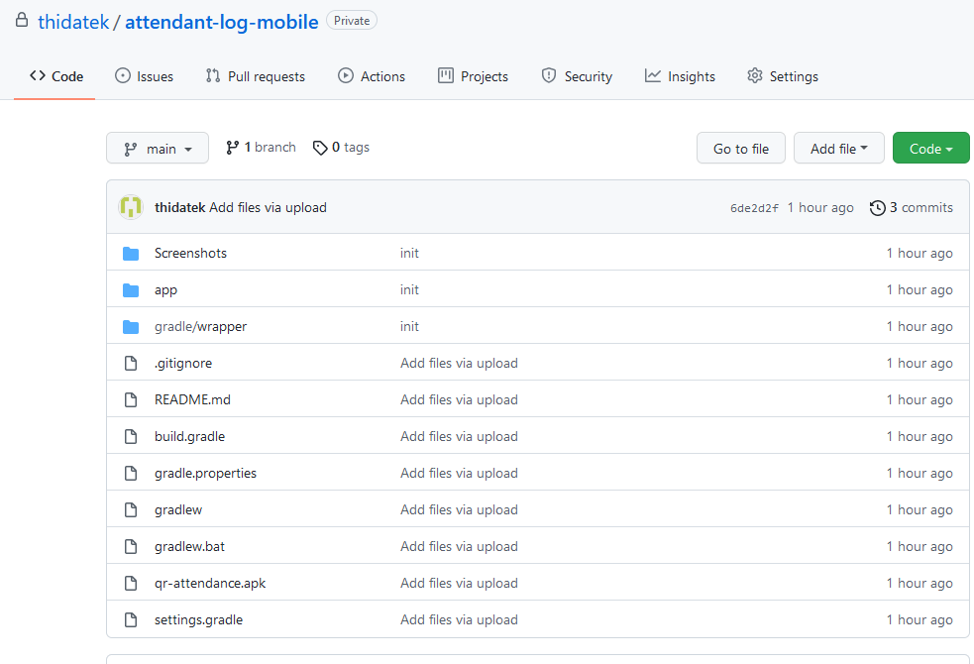
gitHub project
https://github.com/thidatek/attendant-log-mobile.git

Slide 8
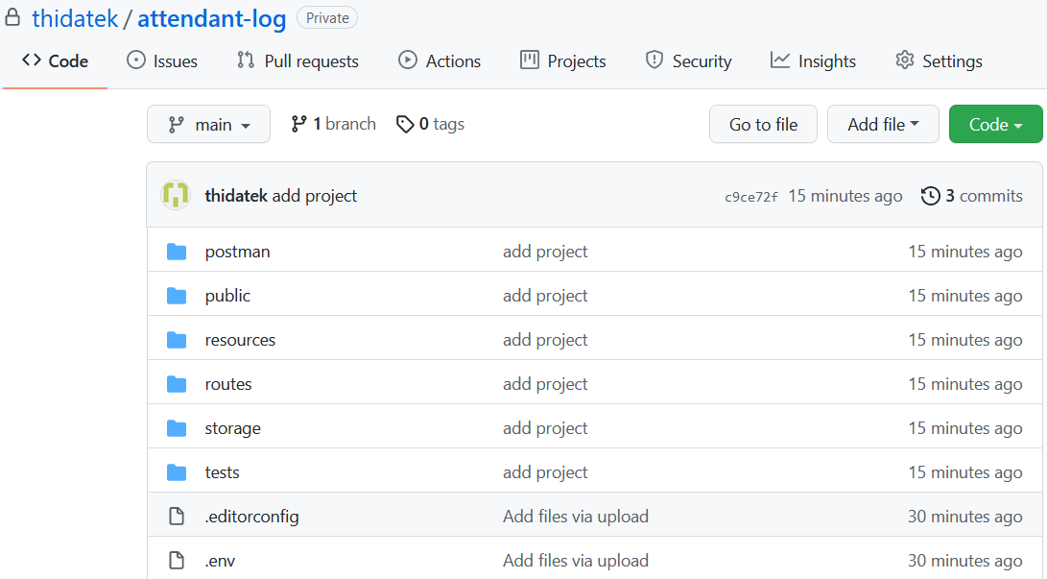
gitHub project
https://github.com/thidatek/attendant-log.git

Slide 9
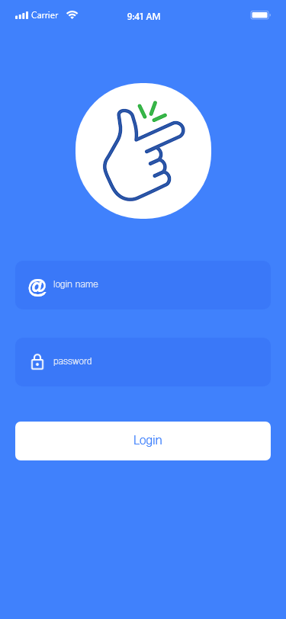
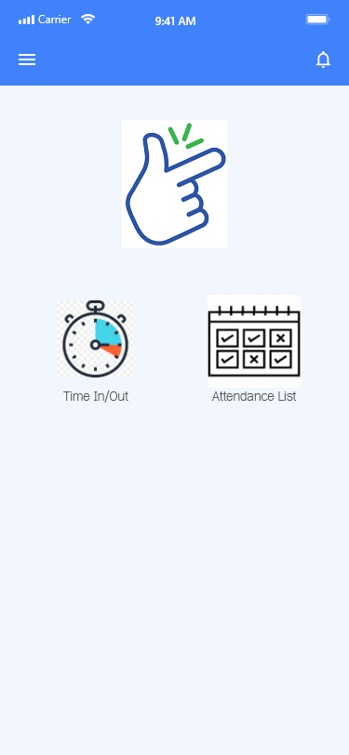
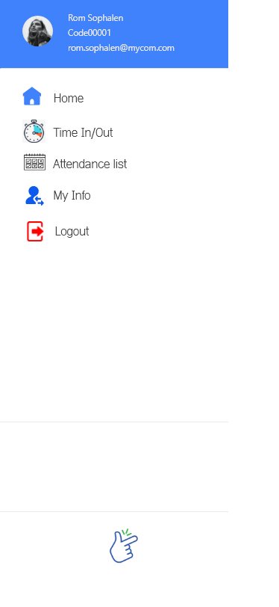
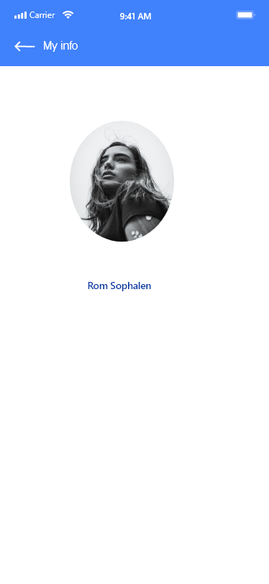
prototype

Slide 10
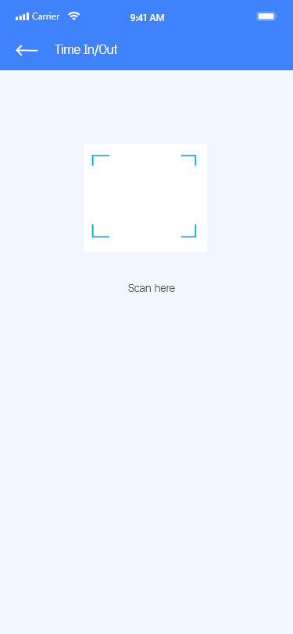
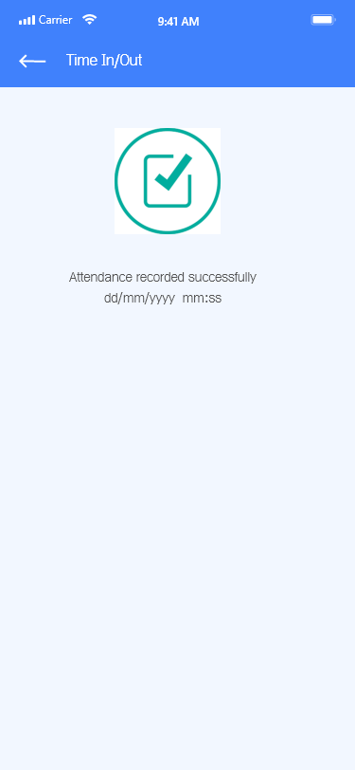
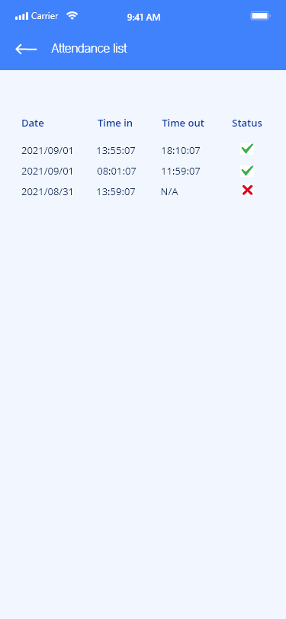
prototype

Slide 11

Progress
1. Have you had all documents references to do your topic?
2. Have you arrange all algorithms/pseudocodes to do your topic? Can you give a quick view in one page.
3. Have you structure your Core/API project yet? (e.g. existing API or laravel or wordpress or .net or java spring etc.)
4. Have you structure your Android project: Menu / Process activity screen etc.?
5. How many percentage now?

Slide 12
Progress
2. Have you arrange all algorithms/pseudocodes to do your topic? Can you give a quick view in one page.
3. Have you structure your Core/API project yet? (e.g. existing API or laravel or wordpress or .net or java spring etc.)
2
3
Company policy: 8am to 12am & 14pm to 18pm Generate office location: If the location is correct => attendance is recorded Attendance checking available: Morning: - In 7:30 am to 8:20am - Out 11:50 am to 12:30pm Afternoon - In 13:30pm to 14:20pm - Out 17:50 pm to 19:00pm | Technologies: API: laravel db: Postgresql Mobile: Native

Slide 13
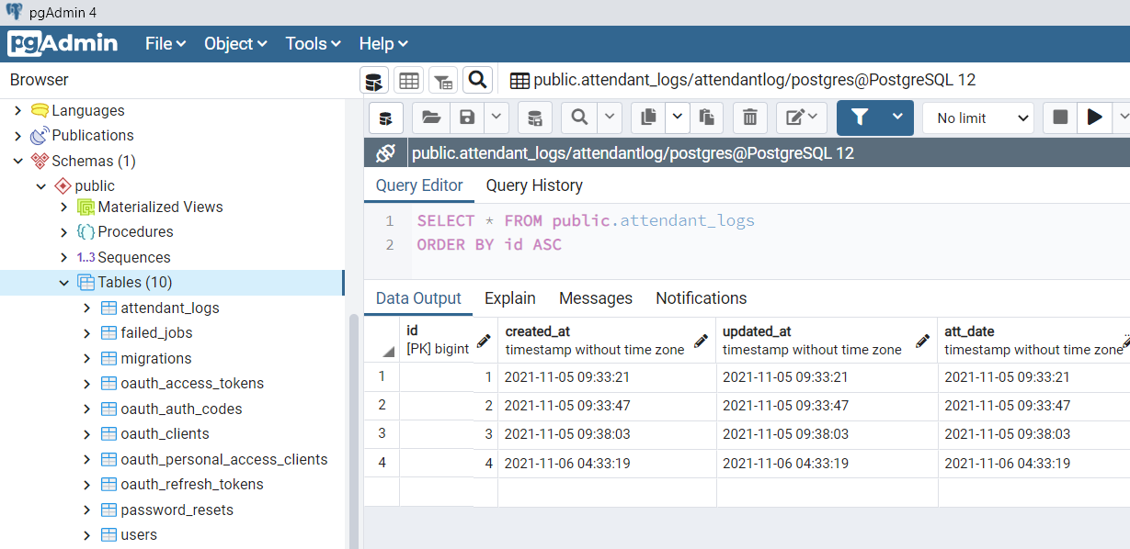
Database

Slide 14
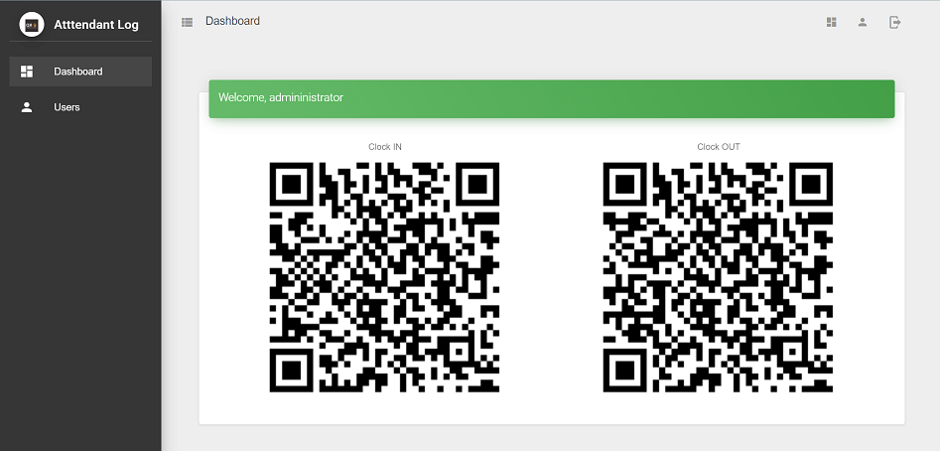
Backoffice screen

Slide 15
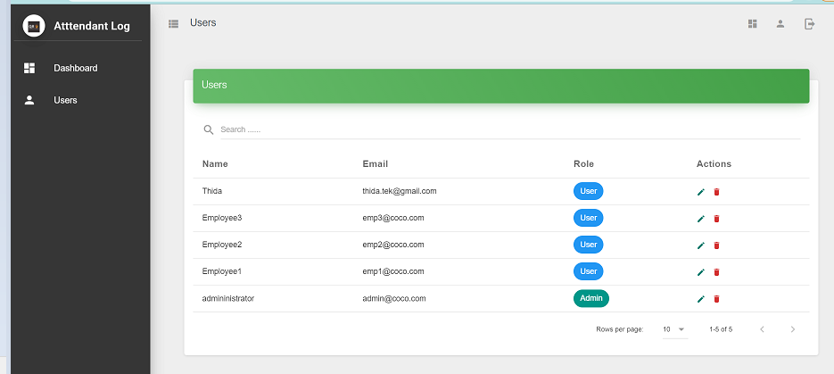
Backoffice screen

Slide 16


